Slide 1














AUTO
VISION

Slide 2

OUR TEAM
MOHAMED EL-SAYED
OMAR ELAZAZY
AYMAN EHAB
SHADY HOSSAM
KHALED IBRAHIM
YOUSSIF RAGI

Slide 3
PROJECT IDEA
AutoVision :is a data analysis project focused on car sales, pricing, and models. The aim is to clean and analyze the dataset, uncover patterns and trends, build forecasting models, and create an interactive dashboard to support decision-making for car dealerships.

Slide 4
DATASET
this dataset has 9 coulmns
and 4345 Row

Slide 5
TEXT COLUMNS
column name | description
Brand | Car manufacturer/brand name
Body | Type of car body
Engine Type | Type of engine fuel
Registration | Indicates if the car is registered (yes/no)
Model | Model name of the car

Slide 6
NUMERIC COLUMNS
column name | description
Price | Selling price of the car (in USD)
Mileage | Mileage driven by the car (in thousands of kilometers)
EngineV | Engine volume/displacement in liters
Year | Year of car production

Slide 7
DATASET INFO
Column no. | Column Name | No. of Rows | Nulls | Type
1 | Brand | 4345 | No Nulls | Object
2 | Price | 4173 | 172 | float 64
3 | Body | 4345 | No Nulls | object
4 | Mileage | 4345 | No Nulls | int 64
5 | EngineV | 4345 | 150 | float 64
6 | Engine Type | 4345 | No Nulls | object
7 | Registration | 4345 | No Nulls | object
8 | Year | 4345 | No Nulls | int 64
9 | Model | 4345 | No Nulls | object

Slide 8
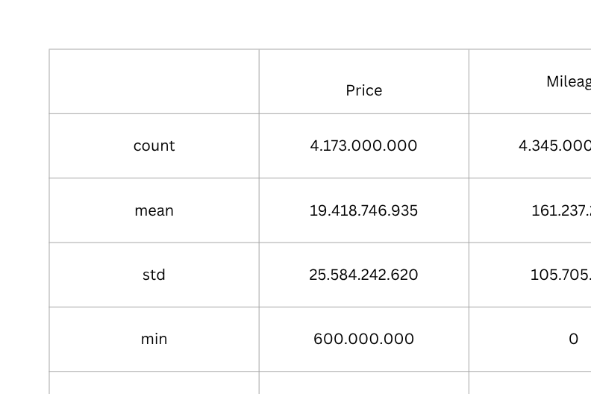
DATA SET DESCRIPTION

Slide 9
WE HAD A PROBLEM
This data set has
  172 null value in Price
  150 null value in EngineV
  73 duplicated row

Slide 10
WHAT WE DID
For nulls:
changing the 172 nulls in (Price) column and the 150 nulls in (EngineV) with mean or median.
For duplicates:
dropping the 73 duplicated rows in the dataset.

Slide 11
CLEANED DATASET INFO
Column no. | Column Name | No. of Rows | Nulls | Type
1 | Brand | 4272 | No Nulls | Object
2 | Price | 4272 | No Nulls | float 64
3 | Body | 4272 | No Nulls | object
4 | Mileage | 4272 | No Nulls | int 64
5 | EngineV | 4272 | No Nulls | float 64
6 | Engine Type | 4272 | No Nulls | object
7 | Registration | 4272 | No Nulls | object
8 | Year | 4272 | No Nulls | int 64
9 | Model | 4272 | No Nulls | object

Slide 12
STAR SCHEMA
“We transformed the raw car dataset into a Star Schema.
In the center, the Fact table contains measures like Price, Mileage, and Engine size.
Around it, Dimension tables describe Brand, Model, Year, Engine Type, and Registration.
This structure makes analysis easier and more insightful.”

Slide 13
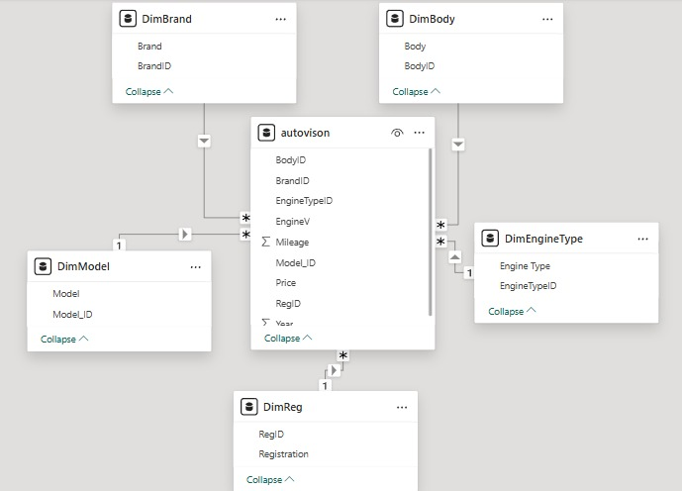
STAR SCHEMA DATA MODEL
      Fact Table → Price, Mileage, EngineV
      Dimension Tables → Brand, Model, Body, Engine, Year, Registration
      Relationships → one-to-many

Slide 14
THANK YOU VERY MUCH!

